Slide 1
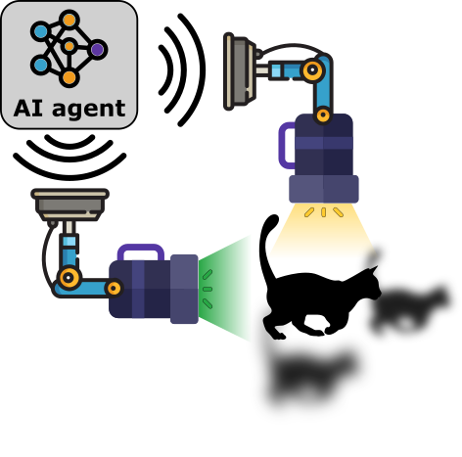

Opportunities for improvement and optimization of the solution
QSciTech–QuantumBC-CMC Virtual Workshop:
Quantum Chemistry 2025
vargashr@mcmaster.ca
Rodrigo A. Vargas Hernández
@RoVargasHdz
Isaac
https://chemai-lab.com
Notes:
I would like to thank the committee for inviting me and giving me the opportunity to talk about my research.

Slide 2
(Intro) Quantum chemistry using quantum computers
Curse of dimensionality (2^{n})
Study molecular processes
Catalysis
OLEDs
drug design
Study chemical reactions
Multiple energy calculations
Energetic Materials Frontiers 2, 292 (2021)
Notes:
Energetic Materials Frontiers 2 (2021) 292–305

Slide 3

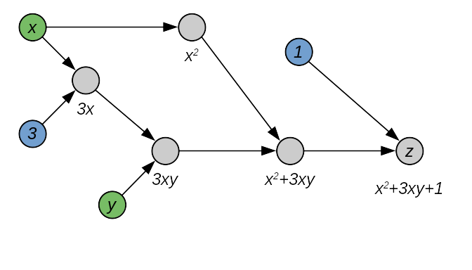
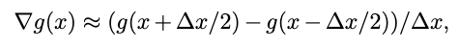
(some) Review papers: Variational Quantum Algorithms → Optimization
Chem. Rev. 119, 19, 10856 (2019)
Quantum 7, 1073 (2023).
Nat Rev Phys 3, 625–644 (2021).

Slide 4
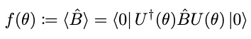
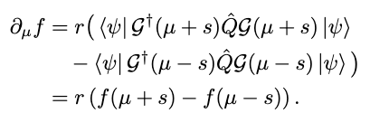
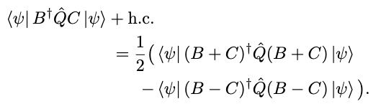
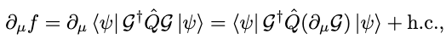
Electronic structure problem
Pauli strings
Fermion to Qubit mapping
(Jordan-Wigner)
Orbitals’ space
Qubits' space

Slide 5


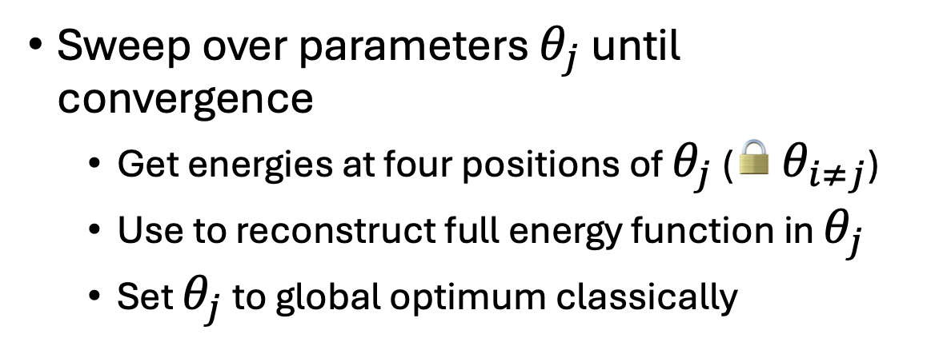
Variational Quantum Eigensolver
“find the electronic state with the lowest energy”
Measurement problem
Ansatz optimization
Basis set optimization
“gradient optimization”
“sampling-based optimization”
arXiv:2401.09253

Slide 6
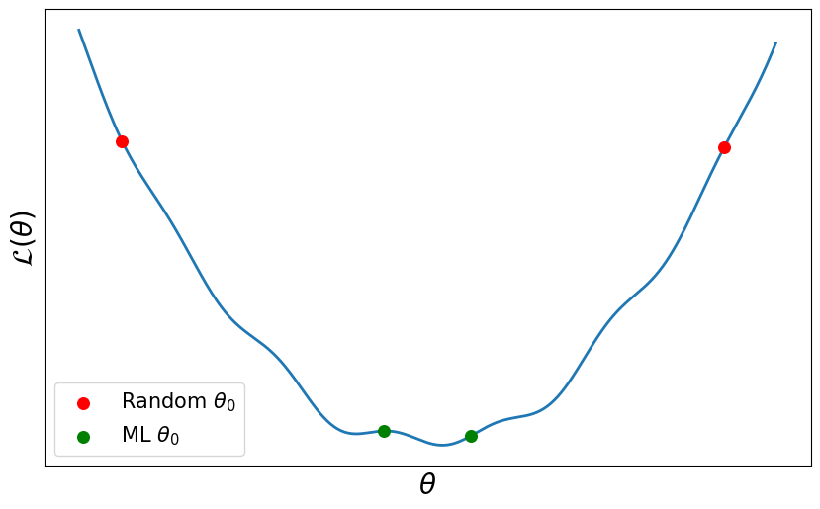
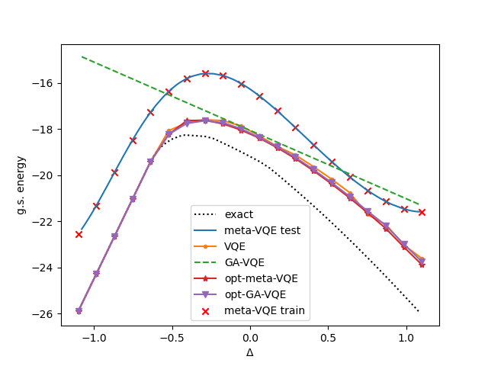
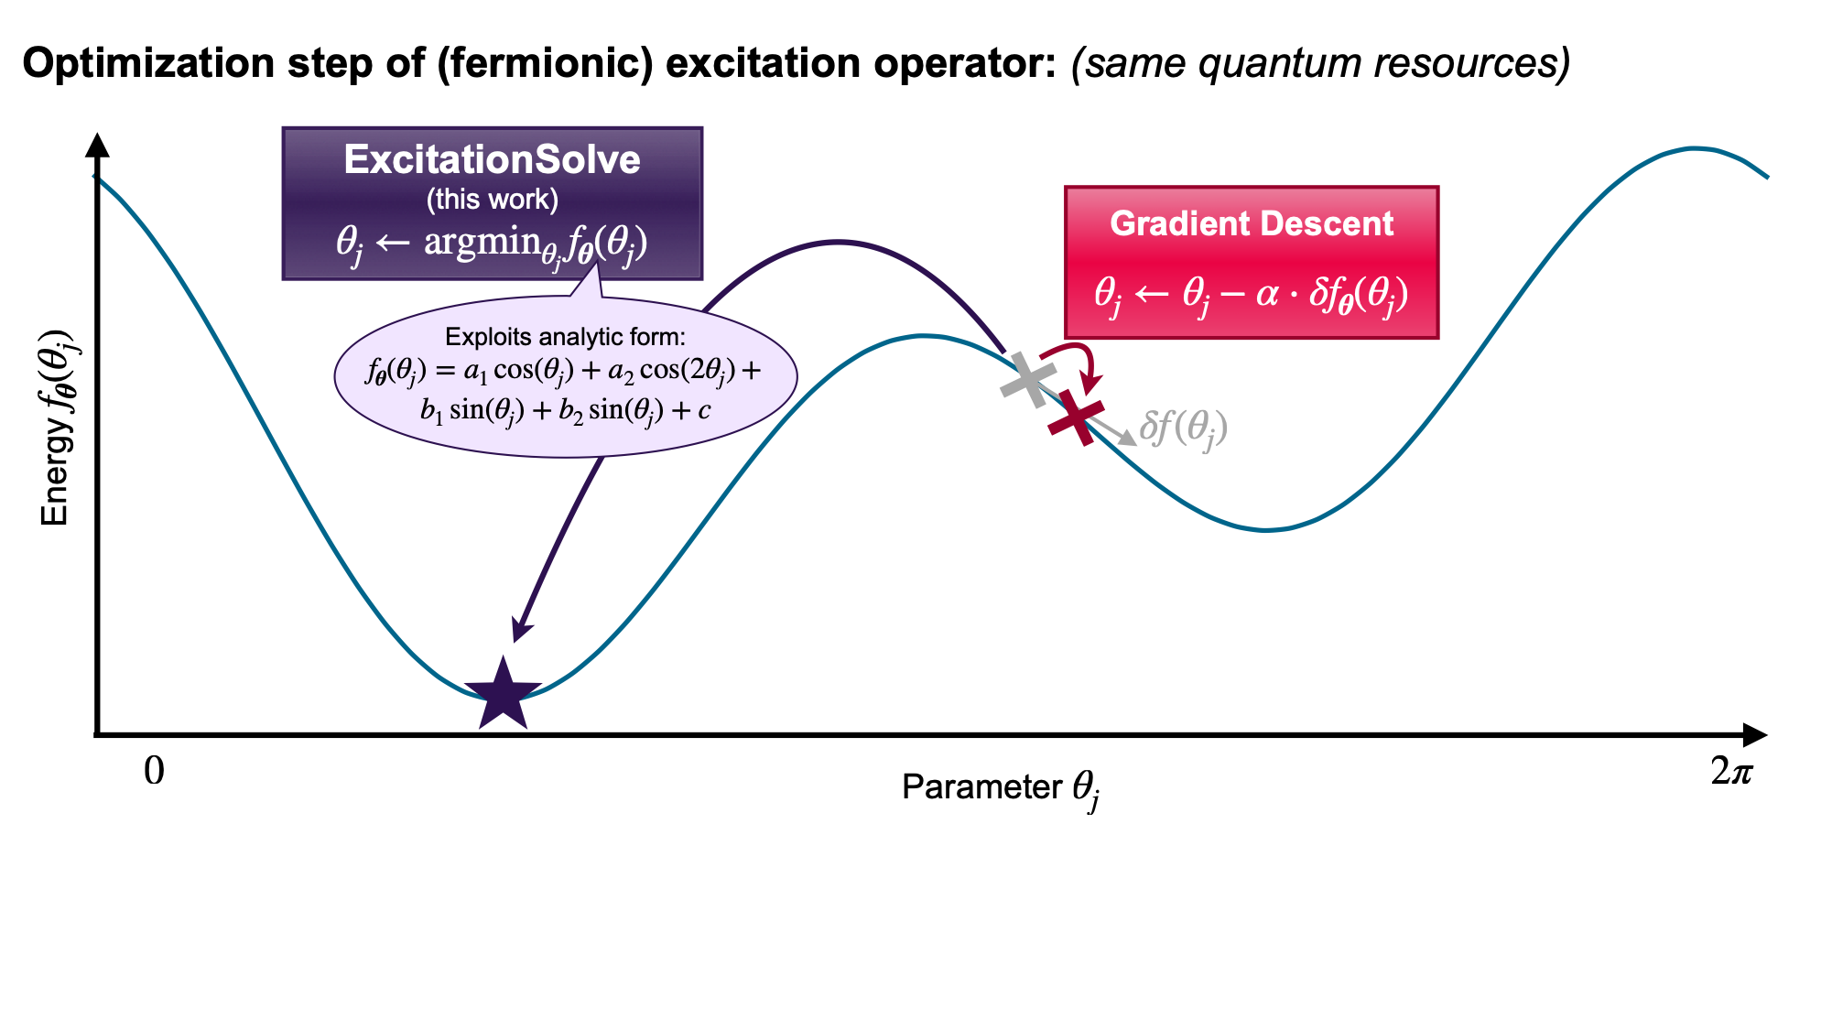
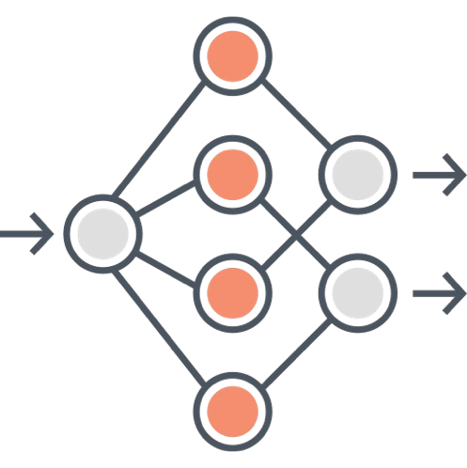
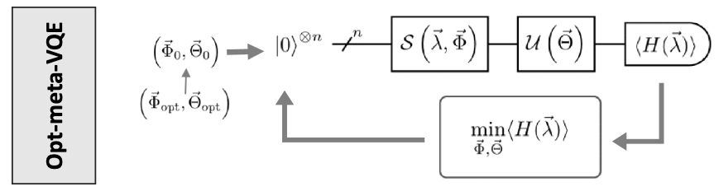
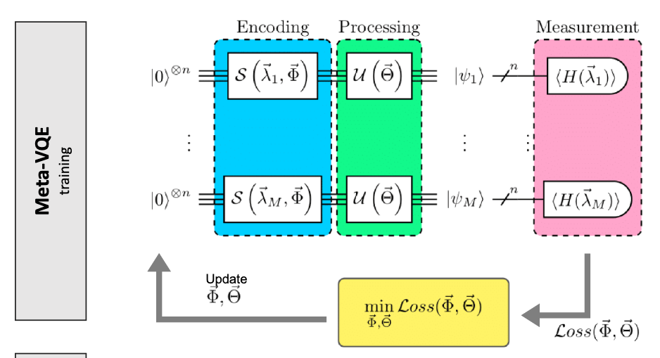
Outline
Differentiable quantum computational chemistry with
arXiv:2111.09967
GFlowNets for Hamiltonian decomposition in groups of compatible operators
*ongoing project
accepted at ML4Phys 2024
arXiv:2410.16041

Slide 7
Differentiable quantum computational chemistry
Gradient Optimization
arXiv:2401.09253
Phys. Rev. A 99, 032331 (2019).
Parameter-shift rule
Automatic differentiation
What about?
ACS Central Science 2018 4 (5), 559-566

Slide 8

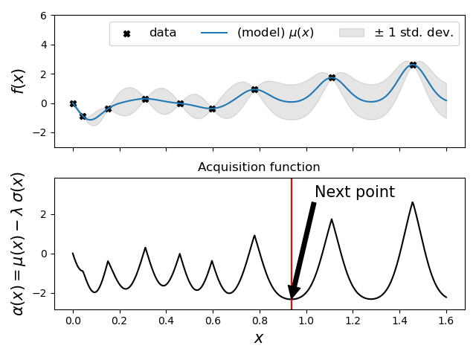
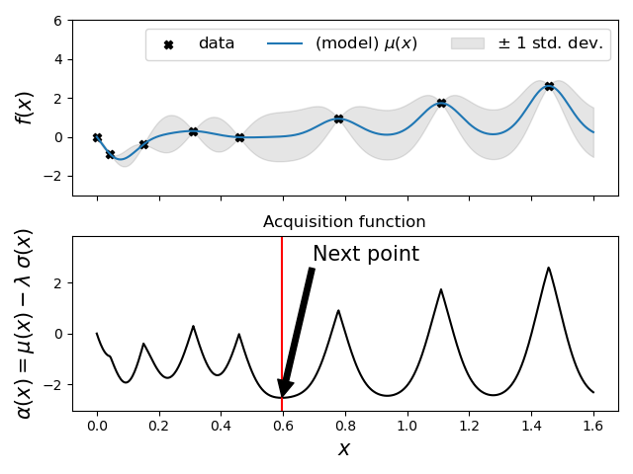
Parameter Shift-Rule: Gradients
arXiv:1811.11184
Classical Gradients:
Quantum Gradients:
Expectation of a gate parameter
Analytical gradients →
Symbolic differentiation →
limited
Numerical differentiation →
2 evaluations per variable
approximation
Automatic differentiation →
forward: 1 evaluation per variable
reverse: 1 evaluation for all variables
Partial derivative
Unitarily generated one-parameter gates G(a)G(b) = G(a + b), this is equivalent to shifting the gate parameter, and we get the “parameter shift rule”
For single qubit gates,
2 evaluations per variable.
reuse of the same circuit
Other:
ancilla qubit and a decomposition of the “derivative of a gate”
Exact, not an approximation as in numerical diff.

Slide 9
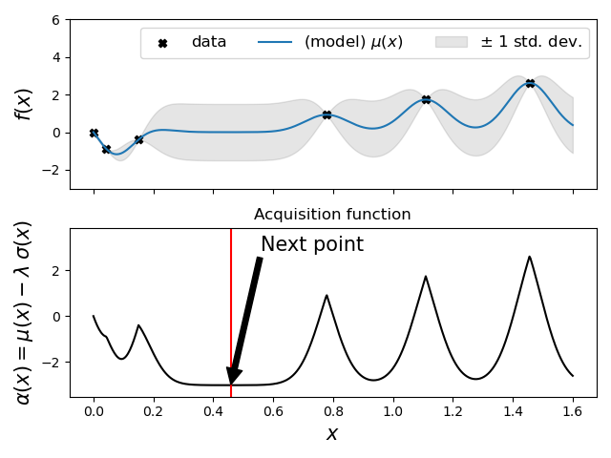
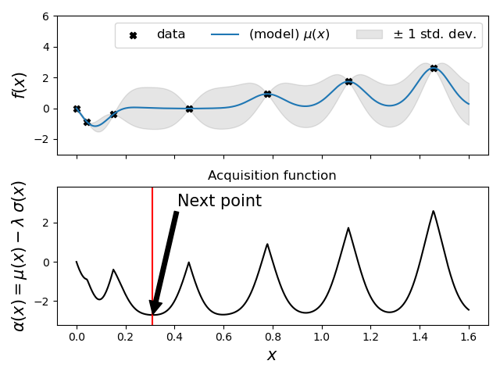
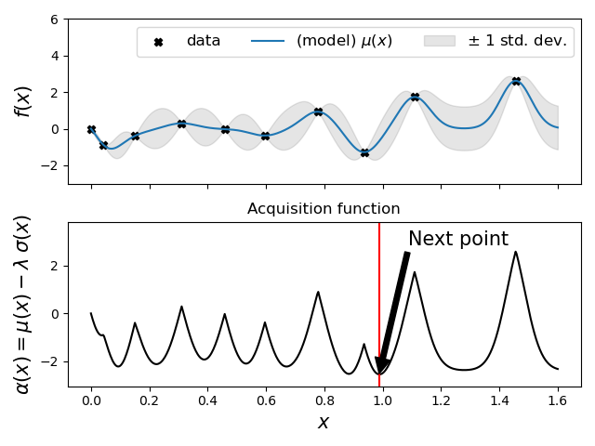
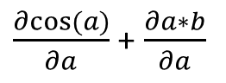
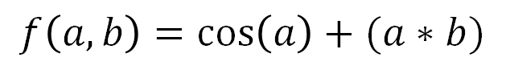
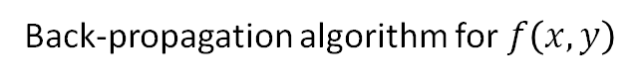
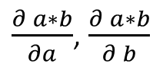
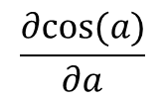
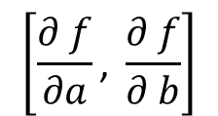
Differentiable Programming 101
A. G. Baydin, et al., J.M. Siskind, J ML R 18, 1 (2018)
Force field or quantum chemistry method
Using the computational graph,
we generate the gradient
$$f\left(a,b\right)=\cos\left(a\right)+(a∗b)$$
$$\frac{∂cos⁡(a)}{∂a}$$
$\frac{∂ a∗b}{∂a}$, $\frac{∂ a∗b}{∂ b}$
$\frac{∂cos⁡(a)}{∂a}$ + $\frac{∂a∗b}{∂a}$
$$\left[\frac{∂ f}{∂a}\text{, }\frac{∂ f}{∂ b}\right]$$
Back-propagation algorithm for $f\left(x,y\right)$

Slide 10
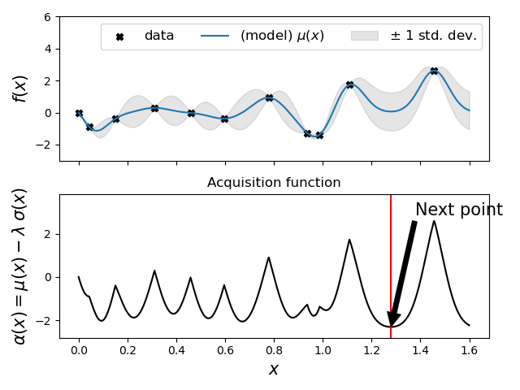
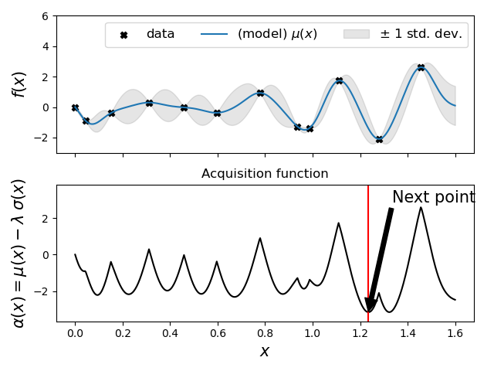
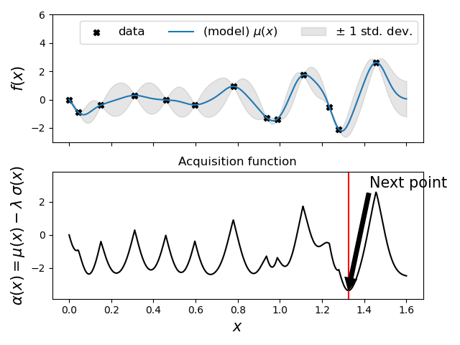
Epiphany moment 1!
J. Schmidhuber (1990)

Slide 11
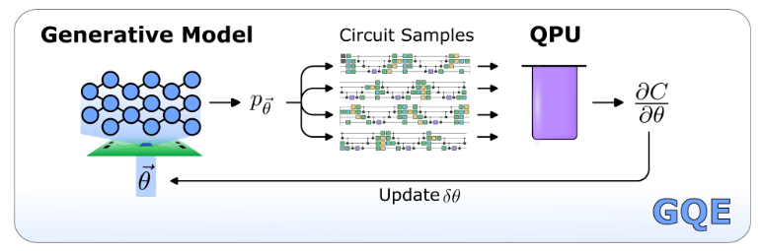
Differentiable quantum computational chemistry (arXiv:1811.04968)
Gradient step

Slide 12
(some) machine learning approaches to accelerate VQE

Slide 13
Variational Quantum Eigensolver
PRX QUANTUM 2, 020329 (2021)
Data driven initial circuit parameterization prediction.
Models:
Optimized with gradient optimization algorithms
d → vector parameterization of quantum circuits

Slide 14
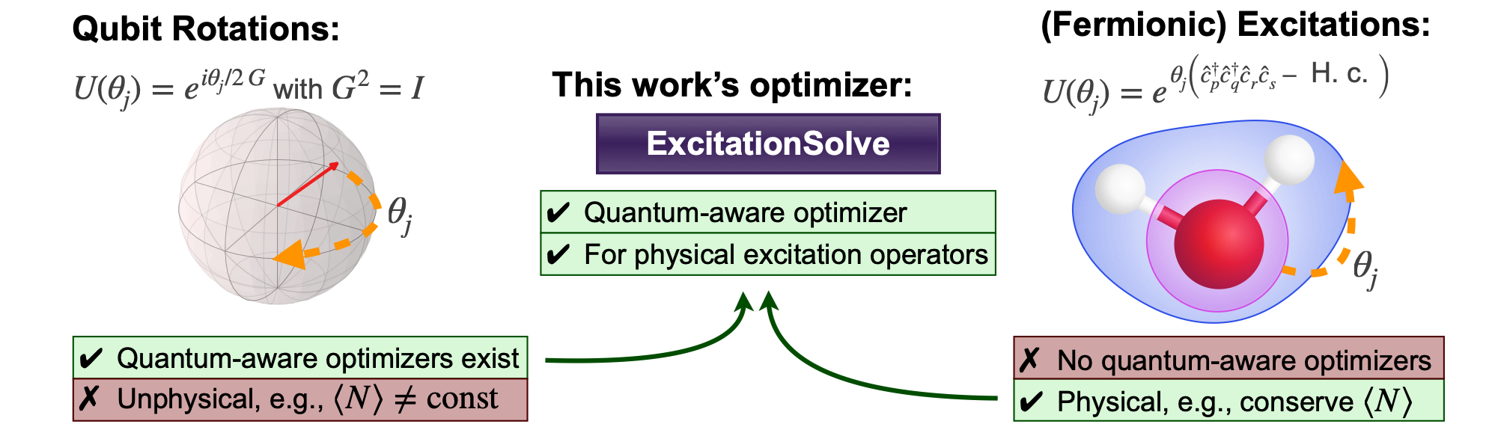
ExcitationSolve: Quantum-aware optimization for Quantum Chemistry
Why quantum awareness?
Why physical ansätze
fast convergence
Example: Converged¹ before first gradient even computed!
respect physically relevant symmetries & properties
Good inductive bias to facilitate optimization (Larocca et al., 2025)
¹ reach chemical accuracy 10⁻³ Hartree

Slide 15
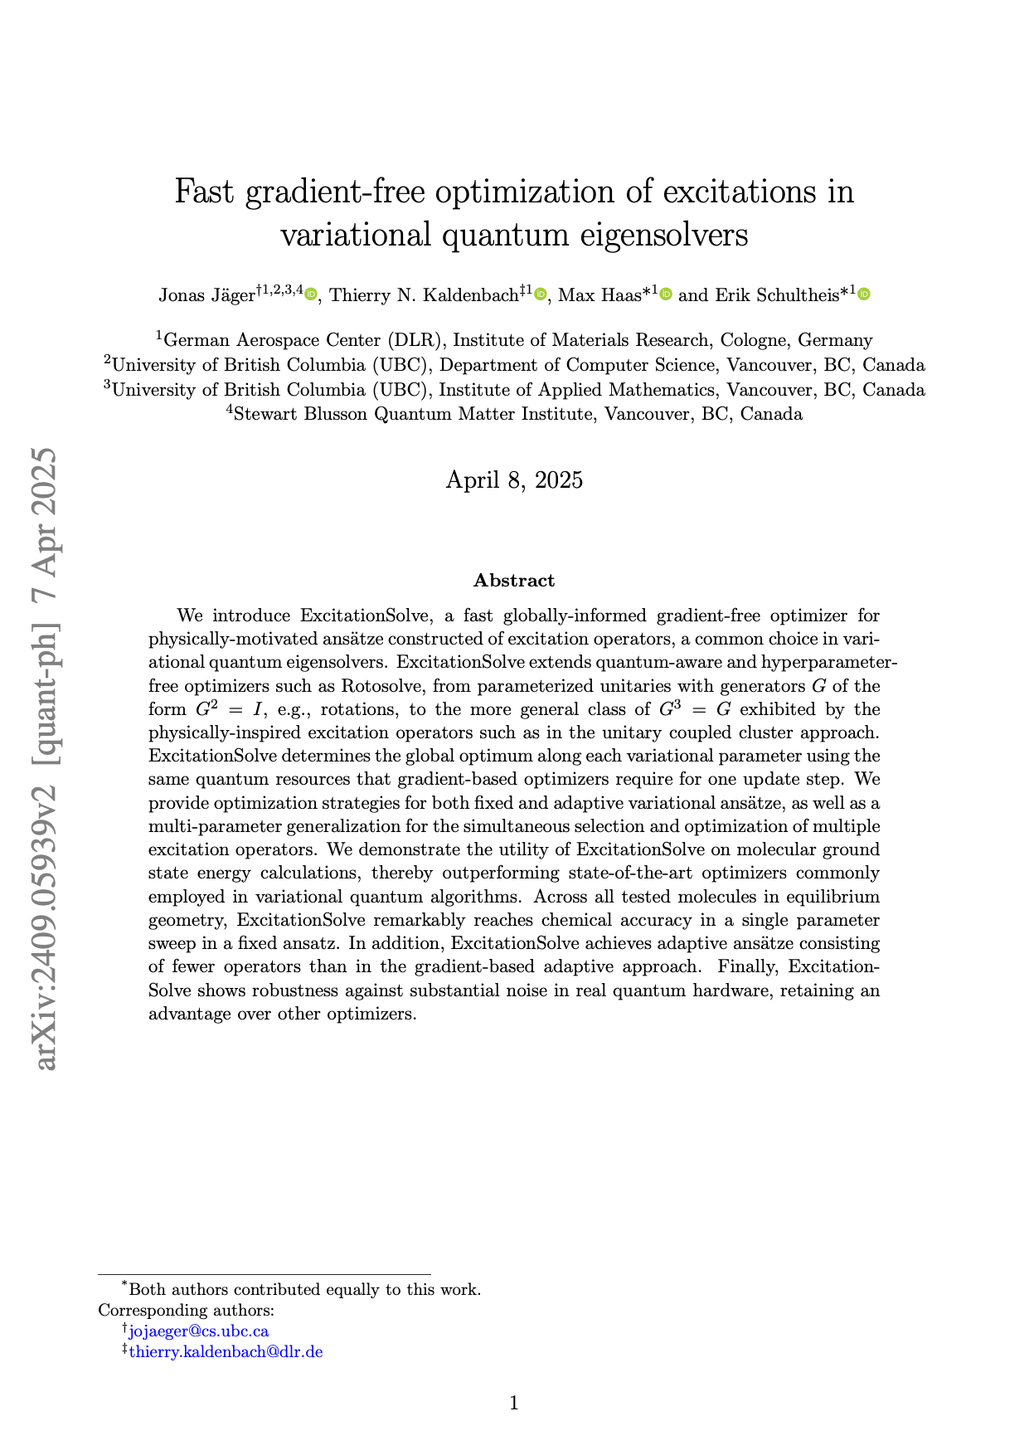
ExcitationSolve: Quantum-aware optimization for Quantum Chemistry
Sweep over parameters $θ_{j}$ until convergence
Get energies at four positions of $θ_{j}$ (🔒 $θ_{i≠j}$)
Use to reconstruct full energy function in $θ_{j}$
Set $θ_{j}$ to global optimum classically

Slide 16
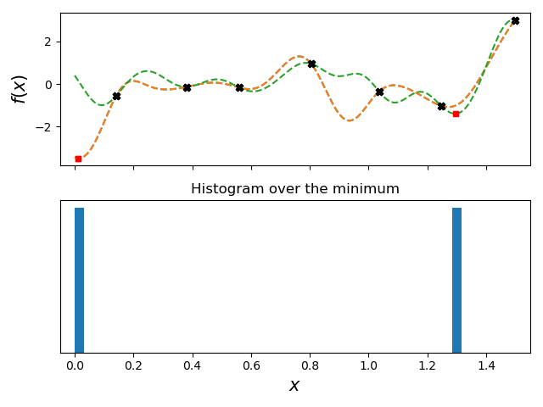
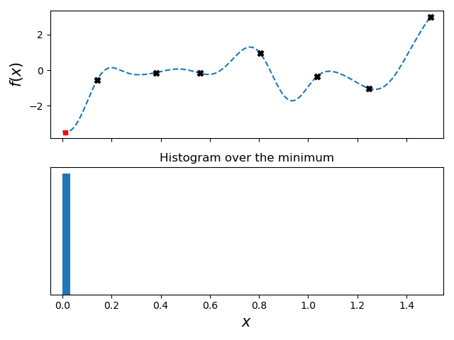
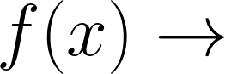
Bayesian Optimization
tutorial
data
models
model
possible minimum
Where is the minimum of ?
black-box function
Notes:
Let’s assume we aimed to find the minimum of an oracle function, meaning we are only able to get one sample at the time. Obviously, we don’t aimed to waste samples by randomly sampling the space.
So one option is to construct a model based on some previously known points of the function problem.
This model will give us a possible minimum of the function, however, there is no certainty that that is the correct model so we could proposed a second one, leading to a second possible location of the minima.

Slide 17
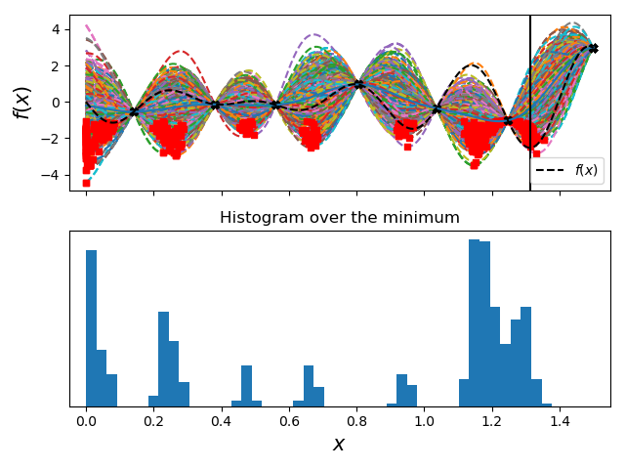
Bayesian Optimization
possible minimum
Things to consider:
Fast training
Easy sampling
Low-data efficient
Notes:
Under the same premise, we could construct or ask multiple experts on the field for possible models and use this as an ensemble of models that could dictate what is the most problable minima.
Obviously, the idea of using multiple experts is not viable as that will require a great amount of time to gather all the models and could add some cost.
This procedure force us to have a model that is easy to train, easy to generate samples, and is low-data efficient.

Slide 18
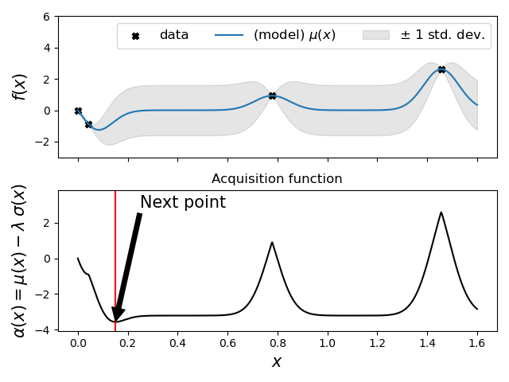
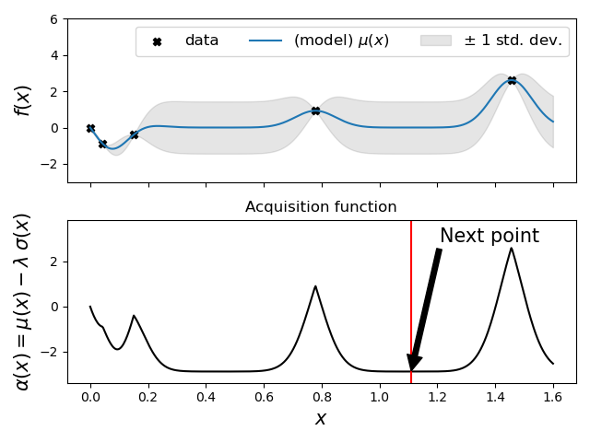
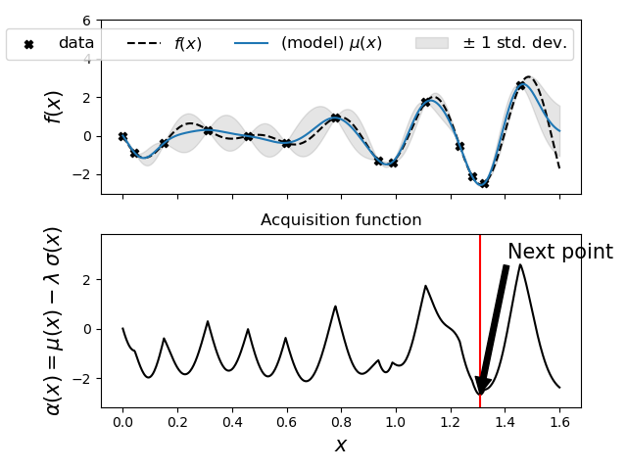
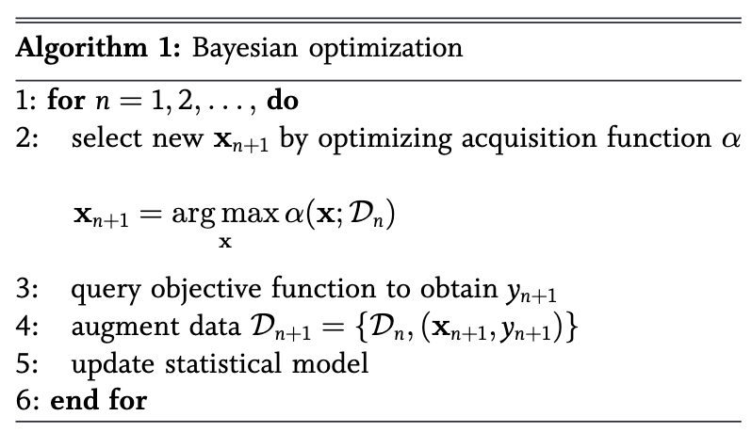
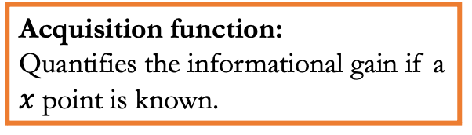
Bayesian Optimization
arg min
Acquisition function:
Quantifies the informational gain if a $x$ point is known.
(book) R. Garnett, Bayesian Optimization (2021)
Notes:
This is the core idea of Bayesian Optimization, a sampling algorithm that generate one sample at the time following a policy dictated by the acquisition function.
by the acquisition function plays a central role as dictates which next point will give us the most information if it was known.
For this example we used the mean and standard deviation of the ensemble predictions to construct the acquisition function
And as we could see my following this policy we were able to find the minimum of the problem function with only a handful of iterations.
What type of ML algorithms could we use for this problem setup?

Slide 19
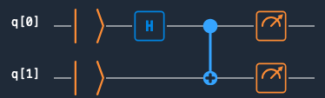
(GPT-QE) generative pre-trained transformer-based quantum eigen-solver
Quantum circuits can be interpretated as text
Quantum Assembly Language
Pauli Strings as Text
arXiv:2401.09253
version 3.0
// a basic cQASM example
/*This is an example
creating one of the Bell states */
qubit[2] q
bit[2] b
init q[0:1]
H q[0]
CNOT q[0], q[1]
b[0,1] = measure q[0,1]
operations = { e^(- i *pool(12).angle * pool(12).pauli ) , e^(- i *pool(17).angle * pool(17).pauli ), e^(- i *pool(9).angle * pool(9).pauli ), ....}
pool = { (pauli=IXXI, angle=0.01), (pauli=IXXI, angle=0.02), (pauli=IXYI, angle=0.01), ...}
Model proposes circuits.
Energies are evaluated.
Model is adjusted to favour the good circuits.

Slide 20
Measurement problem with machine learning

Slide 21
Measurement problem
qubit-wise commuting
Grouping Pauli strings to reduce the number of measurements
J. Chem. Phys. 152, 124114 (2020)
Pauli string

Slide 22
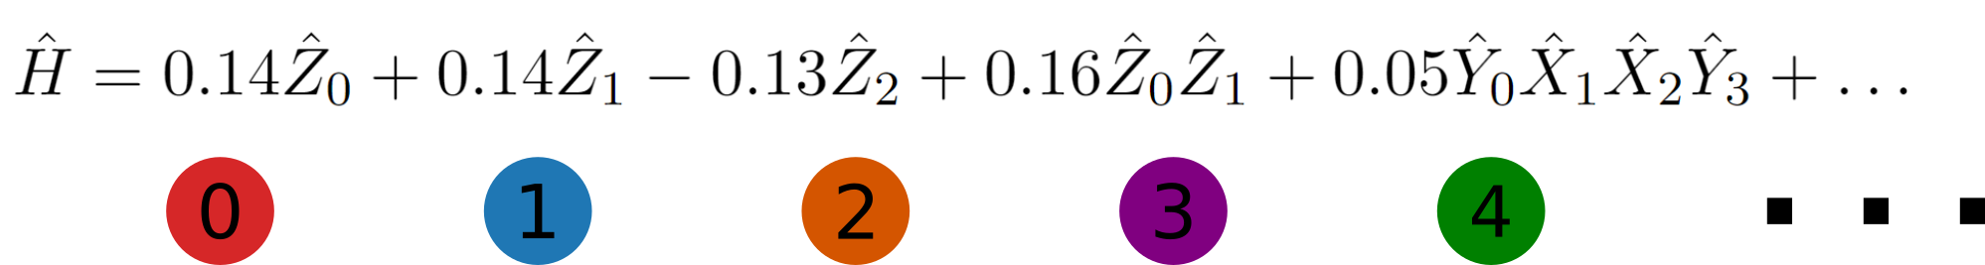
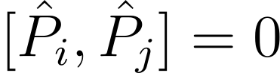
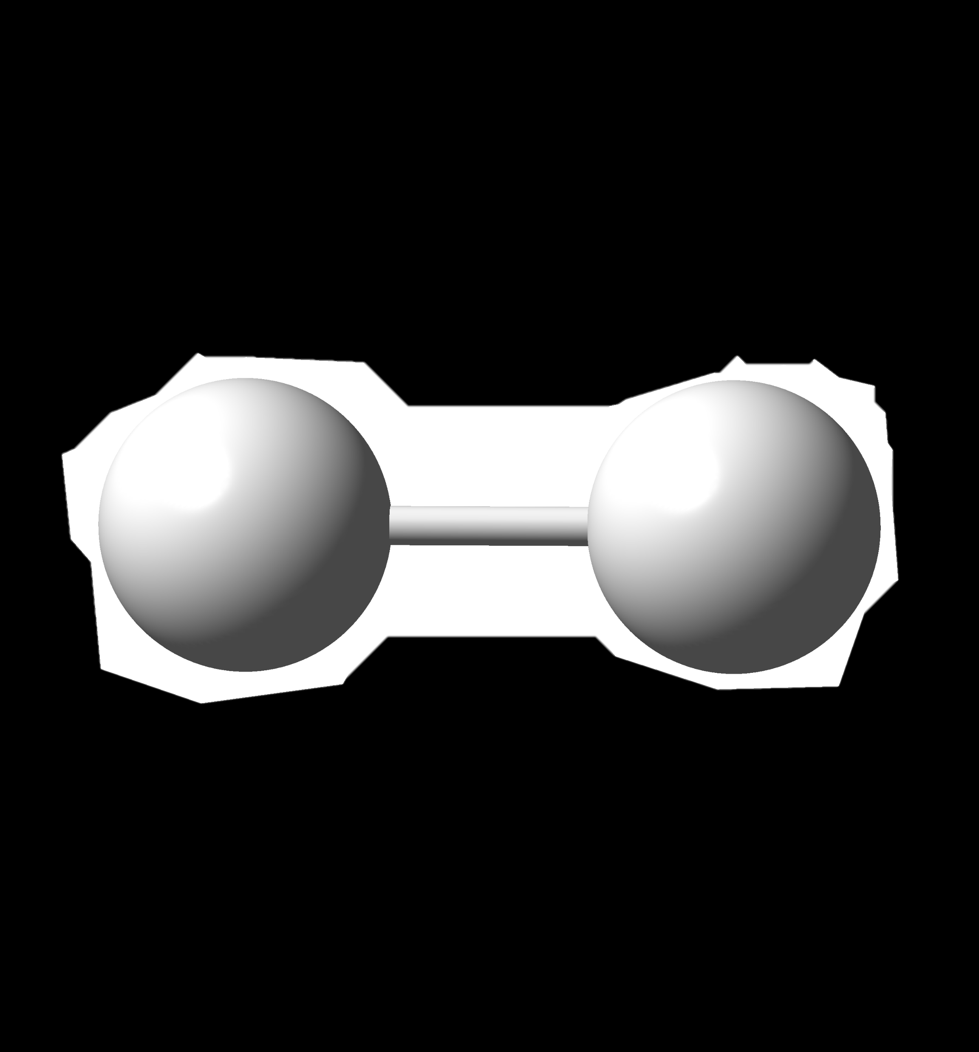
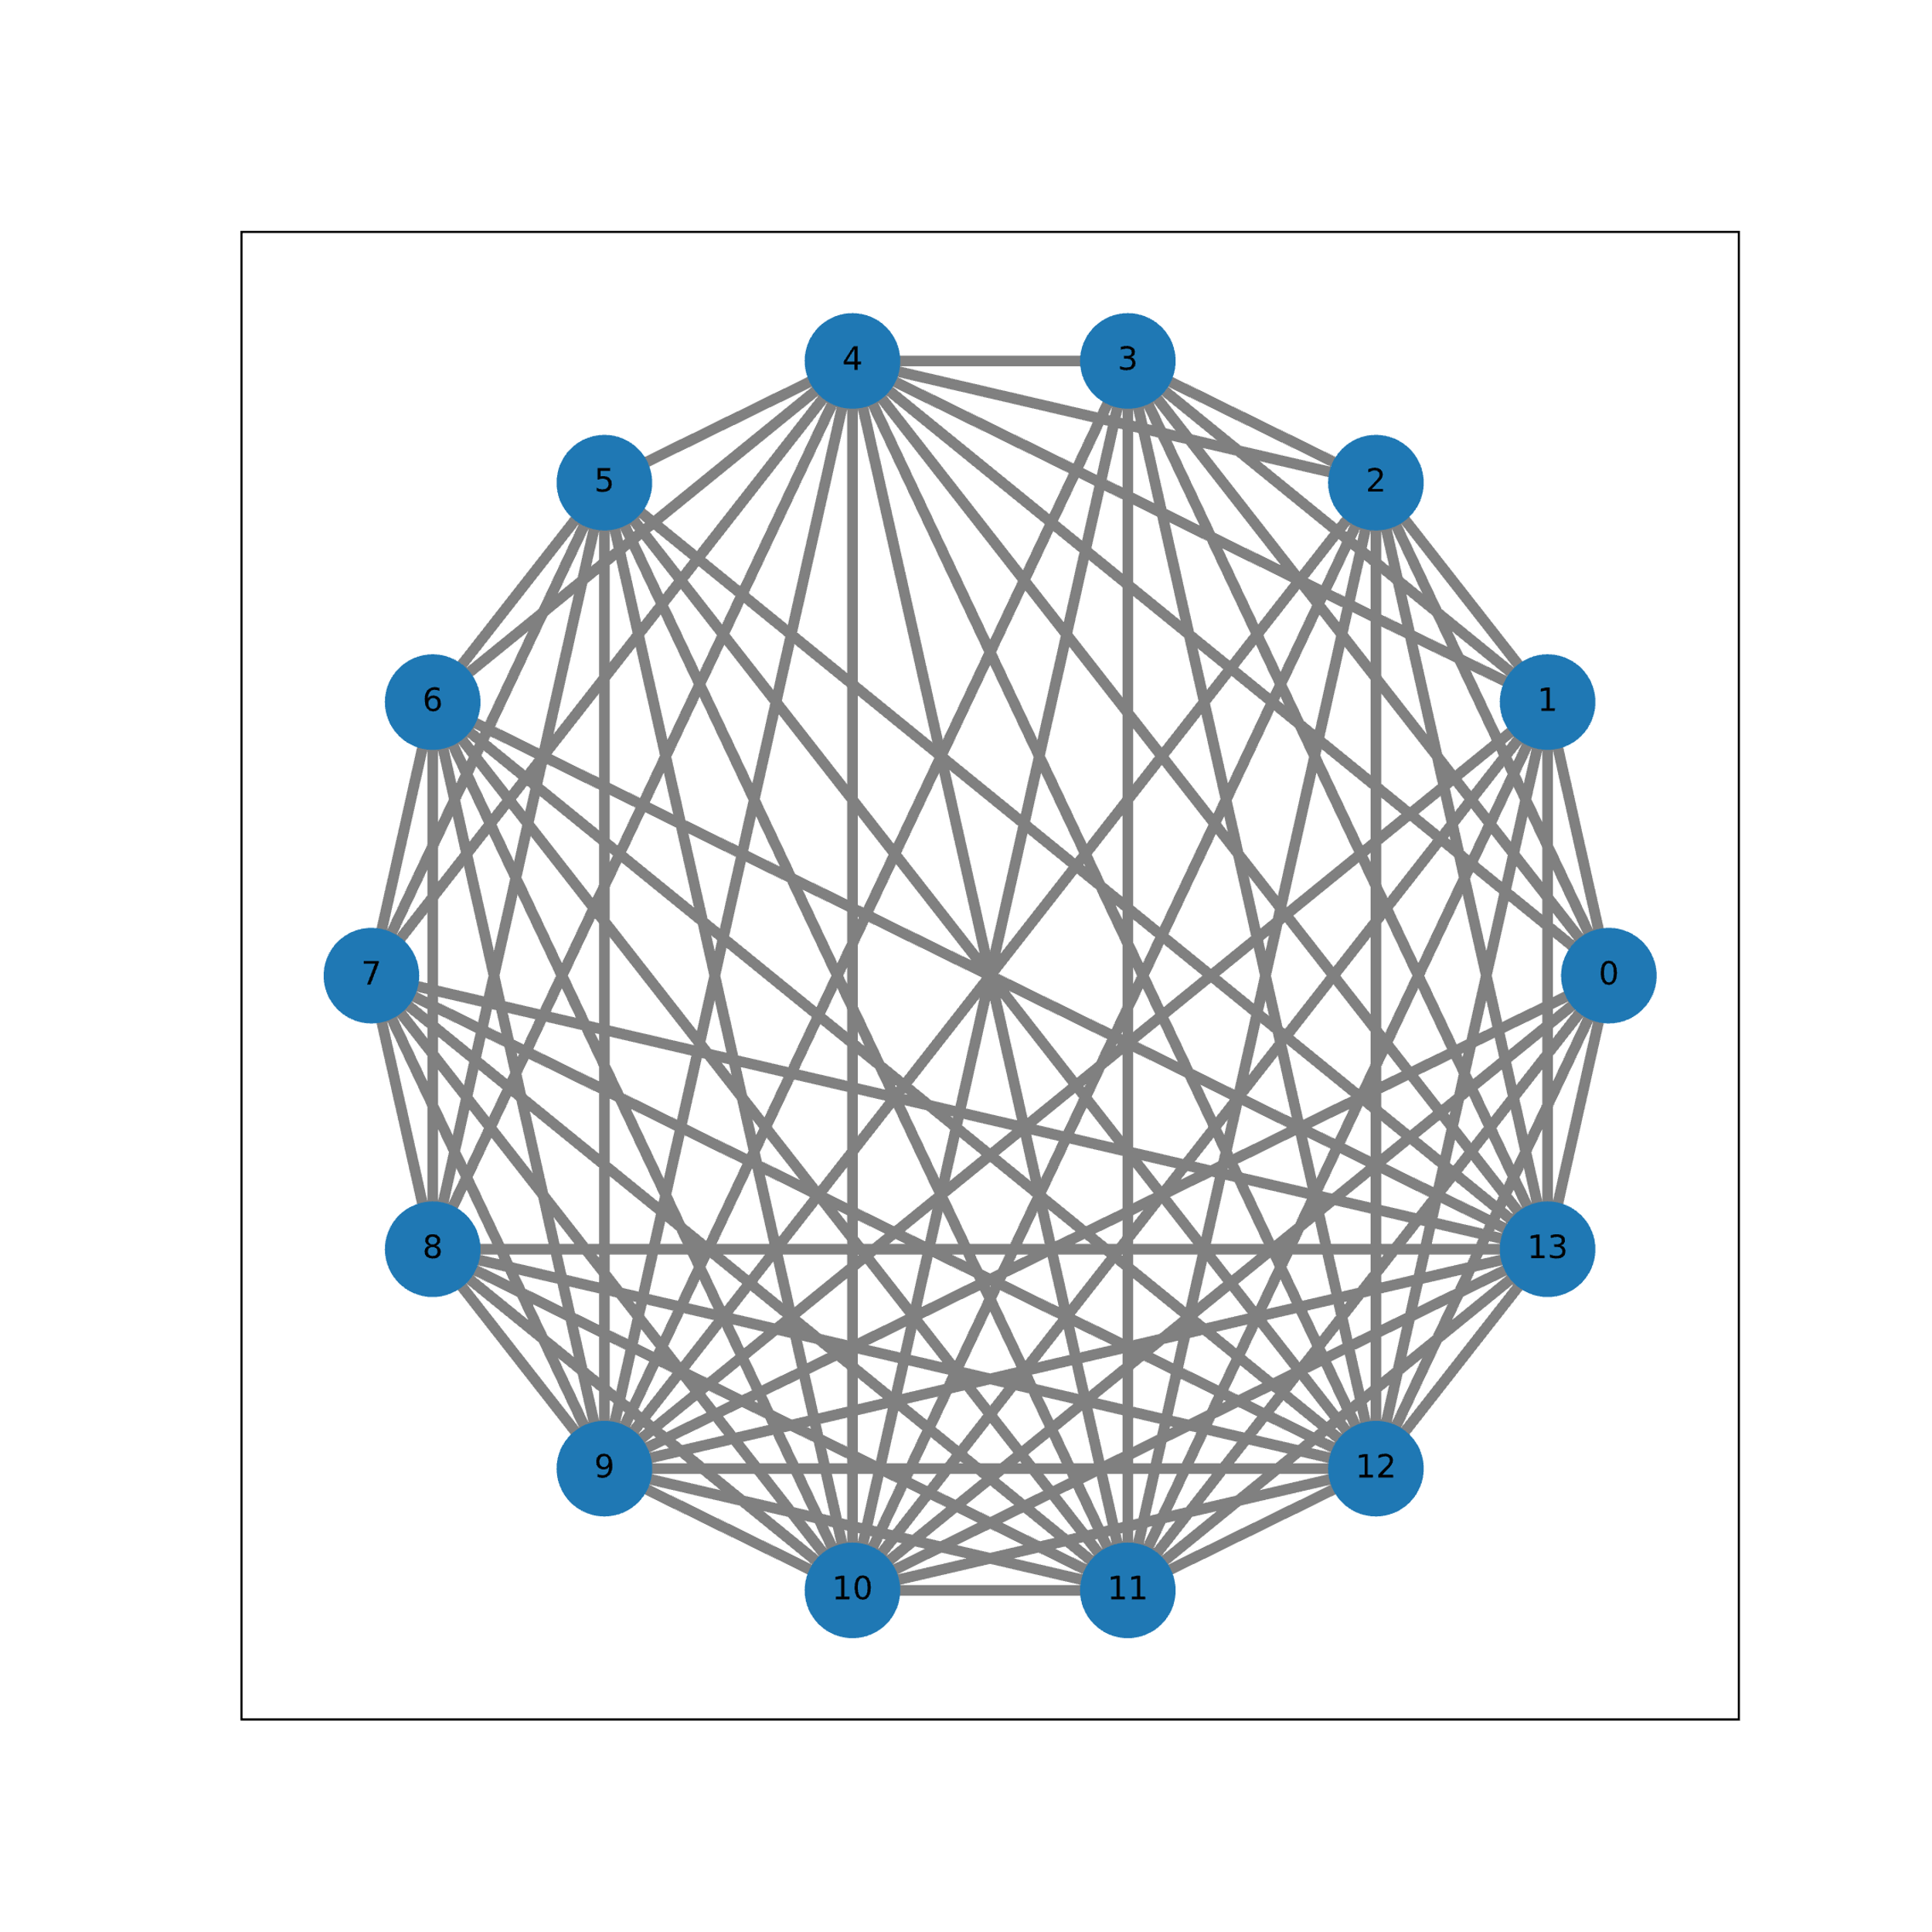
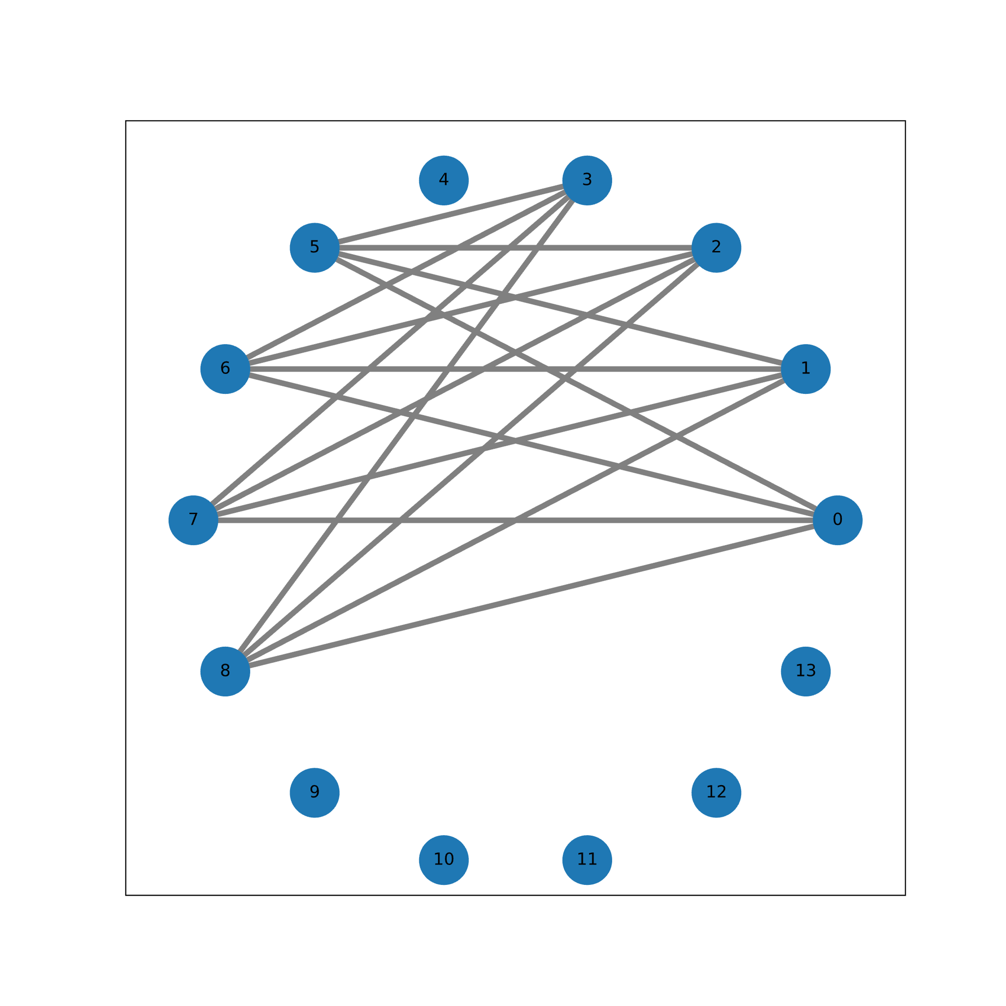
Commutativity graph
Complement of Commutativity graph
NP-Hard
Solve Minimum Clique Cover
Coloring problem
J. Chem. Phys. 152, 124114 (2020)

Slide 23
Same problem as coloring a map ☺
Multiple options!!
Solved classically with heuristics
How do we choose which one is the best?

Slide 24
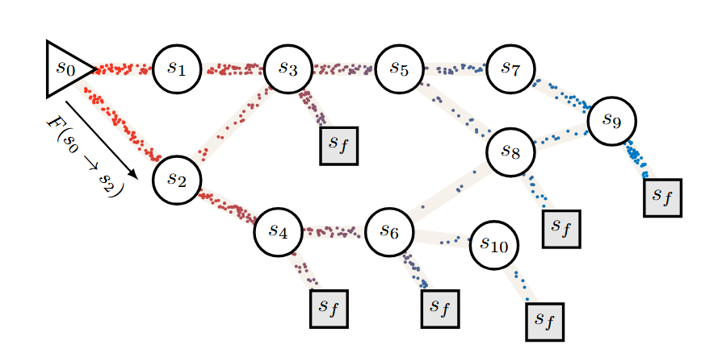
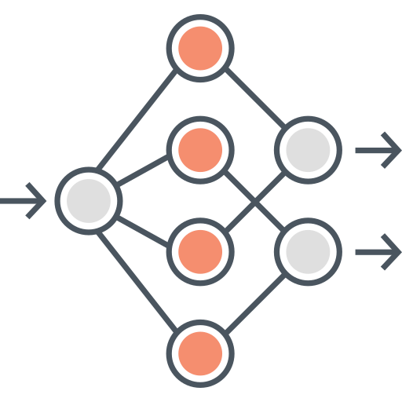
GFlowNets for grouping compatible operators
arXiv:2111.09266
Generative model which parametrizes the probability to reach a terminal state (x) in a direct acyclic graph.
The probability is proportional to a reward function.
We guarantee a Markovian process with a flow matching loss.
Masking functions ensure valid states and may reduce search space.
reward
# Colors graph is the
# Groups to measure
Higher measurement estimate
the lower the reward

Slide 25
GFlowNets for graph coloring
arXiv:2410.16041
Example for the H₂ Hamiltonian. Our masking function ensures graph validity and limits the number of colors.
As example, our masking function is limited to 2 colors just to explain the GFlowNet process.
Notes:
Each state is a graph for which we add a color. Parent states

Slide 26
GFlowNets actions trajectory
It is not immediately clear if this intermediate state is valid for the considered masking.
Let’s look at the trajectory
If restricted to 2 colors, this state will not be sampled!
Trajectory does not generate a valid terminating state.
Thus, the coloring does not belong to the set of actions.
Notes:
en el antrigrafo, nodos conectados no pueden tneer el mismo color

Slide 27
GFlowNets for grouping compatible operators
arXiv:2111.09266
Actions:
Sequential coloring
2-layer MLP, 512 Neurons
Tanh activation
1000 iterations, learning rate 3x10⁻⁴
prob of colors

Slide 28
Results
arXiv:2111.09266
51% / 67%
Requires of the measurements compared to heuristic methods.
LiH
BeH₂
Notes:
NX-lf is greedy largest first, dsat is greedy saturation largest first.

Slide 29
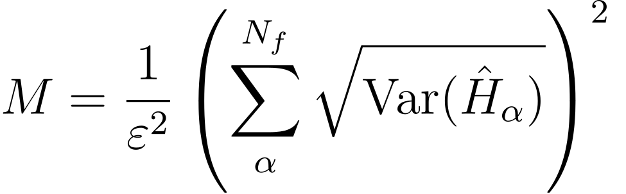
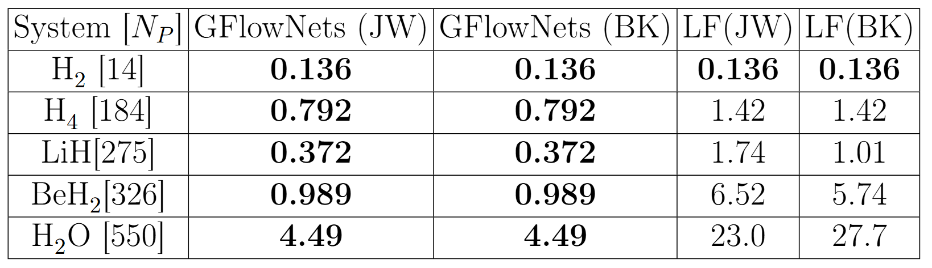




Exact variances
Training protocols
LiH
BeH₂
H₂O

Slide 30
Future Work!
Increase credit assignment via trajectory balance.
Hyperparameter optimization.
Include other grouping techniques.
Flexibility of GflowNets allows its application to other resource optimization problems in Quantum Computing (Circuit design).
BeH₂
Small changes in grouping produce large changes in measurement estimate

Slide 31






Jun (@ Mila)
Sponsors
Summer 2024
Thank you!
Gracias!

Slide 32

Tutorial Content
Mapping electronic structure to qubit space. (Fast review)
Bayesian Optimization
Measurement problem
Graph representation of Hamiltonians
Partitioning schemes (LF, RLF, etc)
GFlowNet
https://github.com/ChemAI-Lab/QSciTech-QuantumBC-CMC-2025

